Slide 1
Trending Videos by Date and Region
by Dmitry Punyansky
Dashboard Link:
https://public.tableau.com/app/profile/dmitry.punyanski/viz/AutomationProject_16527296817420/TrendingVideosbyDateandRegion

Slide 2
Questions:
What video categories were trending last week?
Which video categories trended most often?
How were they distributed among regions?
What categories were especially popular in the United States?
Were there any differences between the categories popular in the US and those popular elsewhere?

Slide 3
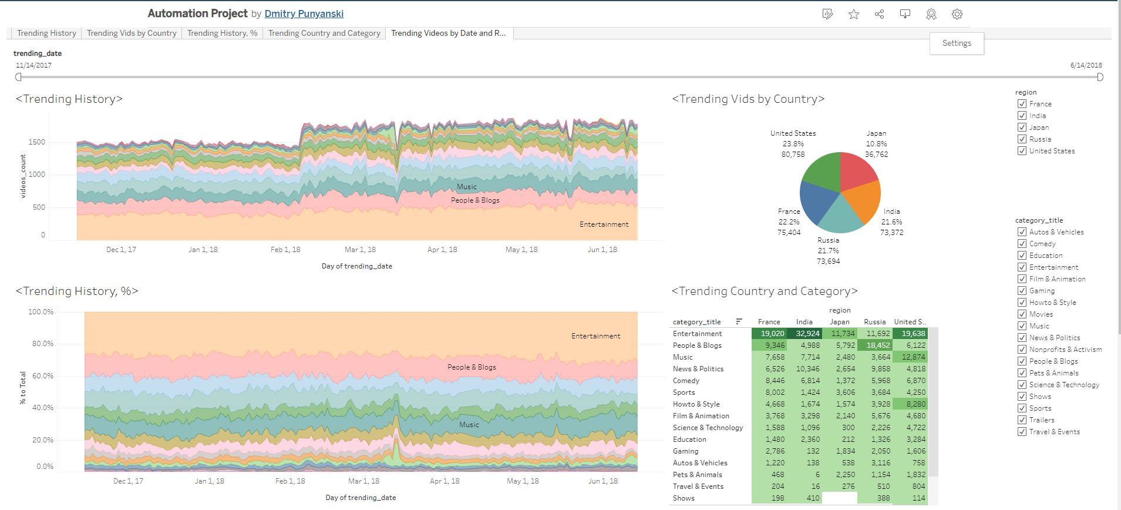
The Dashboard:

Slide 4
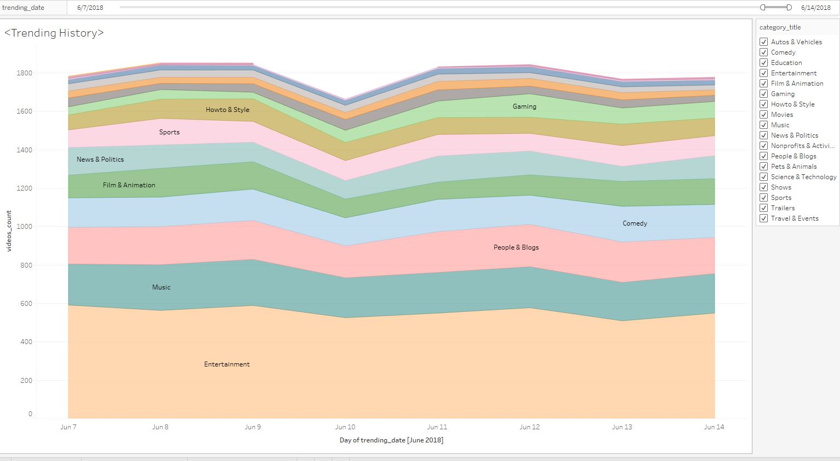
What video categories were trending last week?

Slide 5
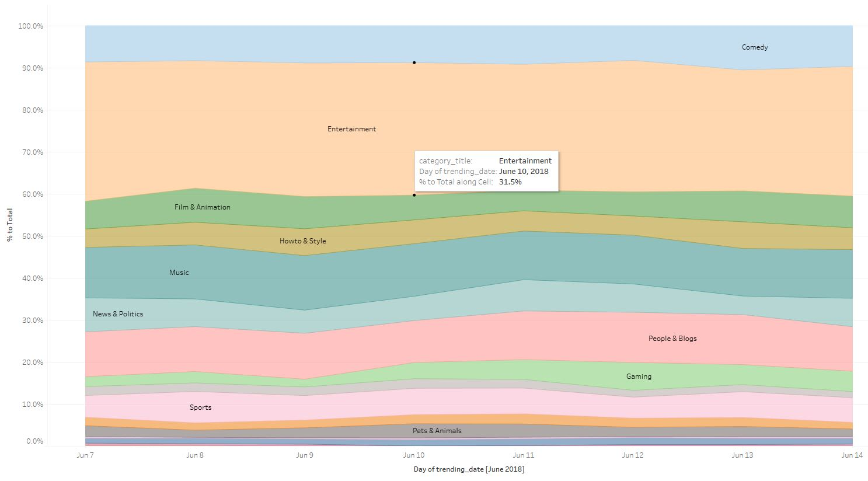
Last week we had mostly Entertainment, Music and People & Blog trending videos.
Entertainment videos was around 30% all week along.

Slide 6
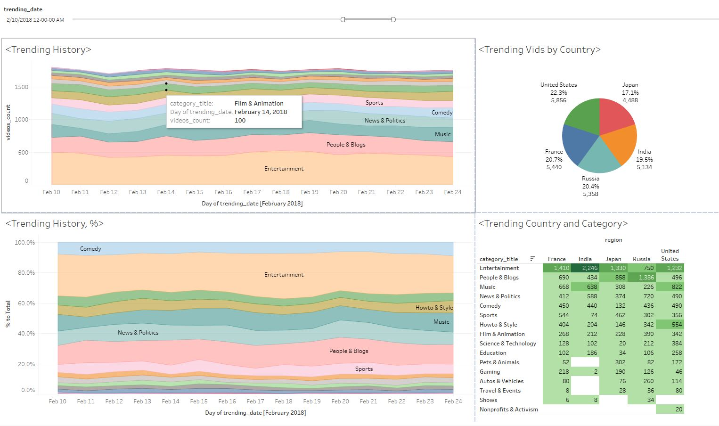
Which video categories trended most often?
Same categories are leading all along. Sometimes they switch places, but our top trending categories are: Entertainment, People & Blog, News & Politics, Music and Comedy. And here is an example of different time period:

Slide 7
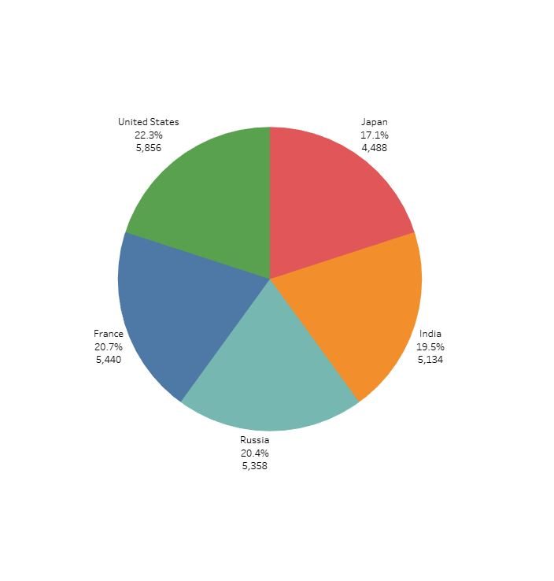
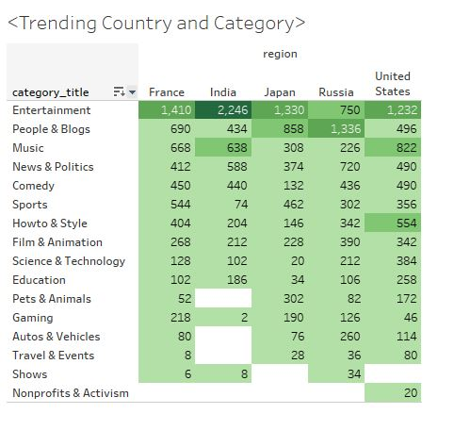
How were they distributed among regions?

Slide 8
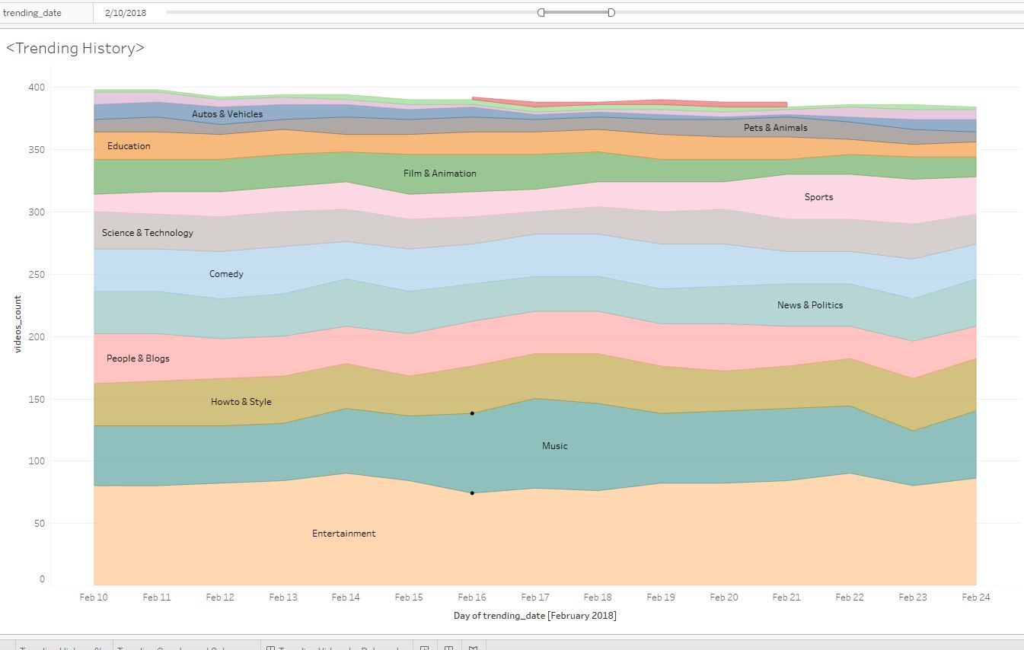
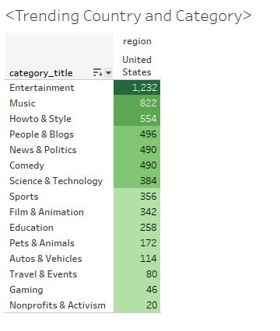
What categories were especially popular in the United States?

Slide 9
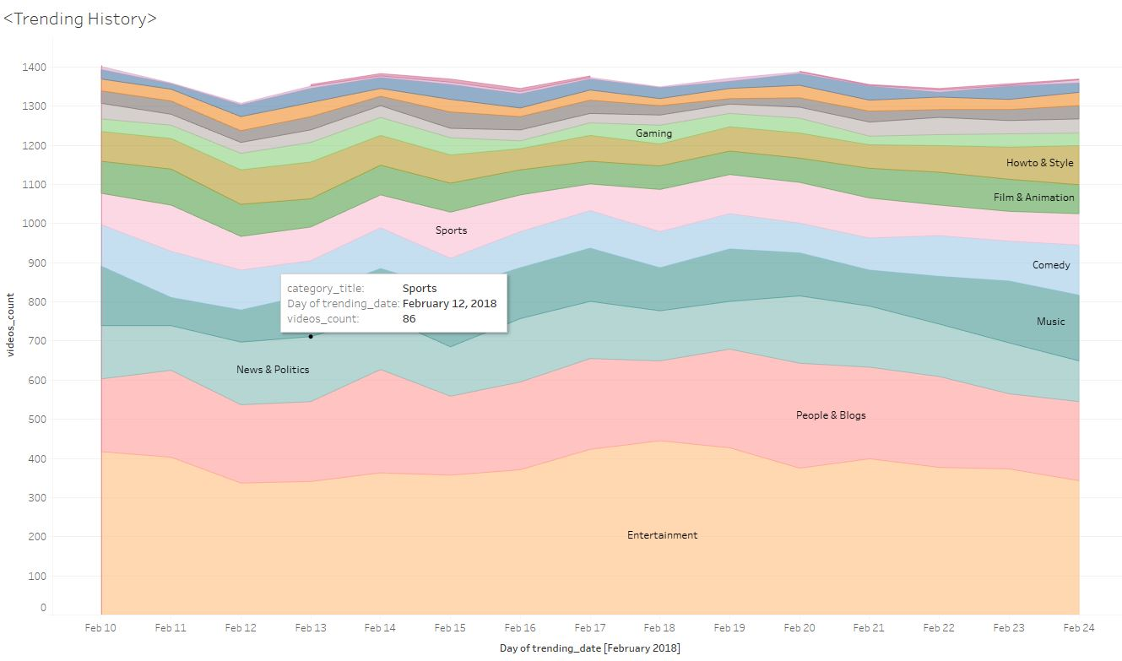
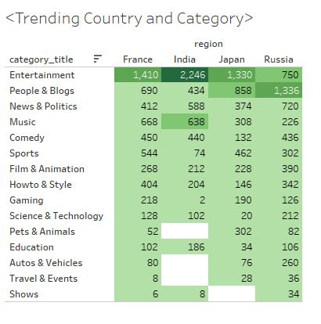
Were there any differences between the categories popular in the US and those popular elsewhere?

Slide 10
Russians are mostly in People & Blog, Entertainment is top in France, India And Japan. And we can see that Indians putting Music to the second place. Howto & Style is on the top five categories with makes USA different (in this case) from other regions.

Slide 11
Thanks!

